Slide 1
IoT Environmental Monitor
Group: May19-45
Advisor: Dr. Geiger
Members: Dong Xing, Haoyue Ma, Yuanzhe Wang, Tyler Fritz, Ahmed Abuhjar
Notes:
Tyler
Soil Moisture, not relative humidity.
Look into gypsum being used as humidity sensor
Electromagnetic Transmission, not Radio Waves
Web server does not need be running all the time because the gateway can buffer data.
We don’t have the expertise to handle security issues. Security needs to be handled minimally, we have considered about this
Be more specific than ‘longer range’. There is a wide range of ‘long’-----(not “the longer the better”, but the “necessary” length)
When describing sleep mode, talk about the actual figure of power savings. ~99.9%-----like your watch
Describe other systems available for the market survey. John Deere’s is one of the more expensive
John Deere supports purchasing leaf nodes for the gateway
Our system could take data every 30 minutes too. Doesn’t need to be a disadvantage

Slide 2
Overview
Project Plan
Problem Statement
Conceptual Sketch
Functional Requirements
Non-functional Requirements
Technical Constraints/Considerations
Market Survey
Potential Risks & Mitigation
Cost Estimate
Milestones and Schedule
System Design
Functional Decomposition
Detailed Design
Technology Platforms Used
Test Plan
Prototype Implementations
Conclusion
Current Project Status
Task Responsibilities
Next Semester and On
Questions
Notes:
Tyler

Slide 3
Project Plan
Notes:
Tyler

Slide 4
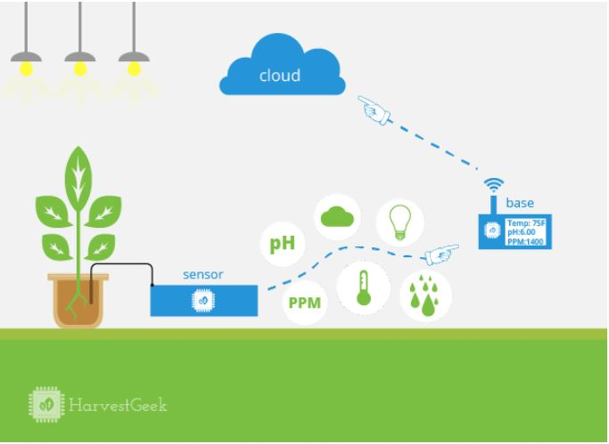
Problem Statement
…...Let me take a look, it’s time to plant, harvest and irrigate my fields to result in higher yields.
HarvestGeek IoT model in farming
Notes:
Ahmed

Slide 5
Conceptual Sketch
3G
Gateway
Electromagnetic Transmissions
Sensor Nodes
Web Server
User Interface
User
Notes:
Dong

Slide 6
Functional Requirements
Sensors detect and measure Relative Humidity(RH) in a wide range (20% - 90%) (result in a variety of conductance/resistance for different ranges of RH)
Sensor nodes transmit and receive radio signals at a distance of 1 km
Gateway Node receives all sensor data and uploads it to web server via 3G and HTTPS.
Web Application hosts and displays data in intuitive fashion
Web server is always available and publicly facing.
Sensor nodes wake up to transmit data twice each day.
Sensor nodes take data every 30 minutes.
Notes:
Ahmed
Tyler
Haoyue and on

Slide 7
System & Performance Requirements
Reliability
The web server and nodes must be able to handle transient overload without losing any points of data.
The gateway and sensor nodes must immediately run our programs on startup.
Each packet must travel from sensor nodes to the gateway node in under one minute.
Web page must be able to load in under five seconds.
The time it takes for the soil moisture sensors to stabilize should be under two minutes.
Notes:
Haoyue

Slide 8
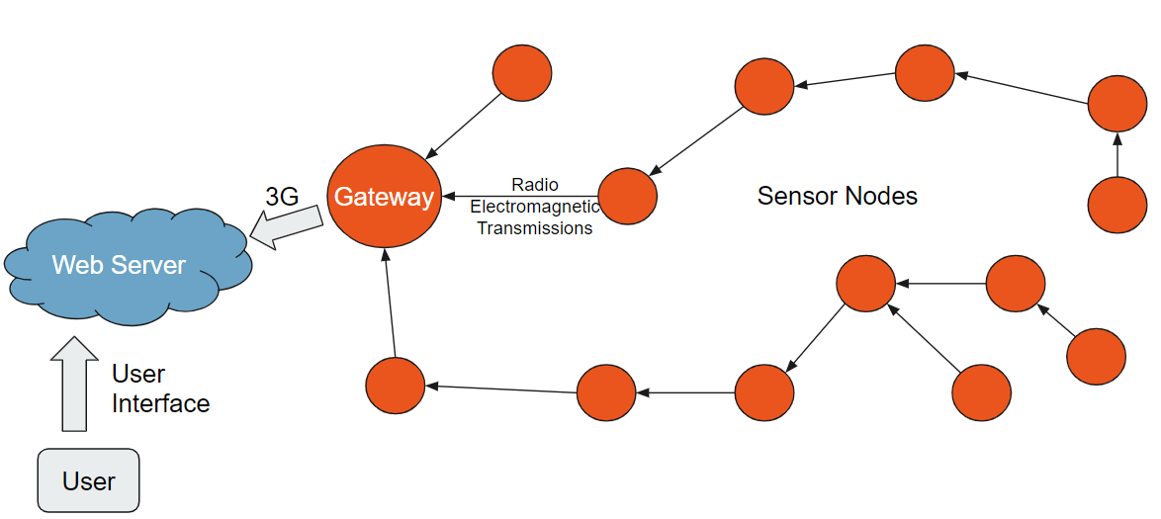
Technical Constraints and Considerations
Modules that grant access to cellular networks are expensive at $70.
Sensor nodes must have minimal power consumption.
Sensor nodes must be dispensable
Buying longer range radios reduces the number of nodes required but increases the power use
Radio messages are not always received correctly due to interference.
Notes:
Ahmed

Slide 9
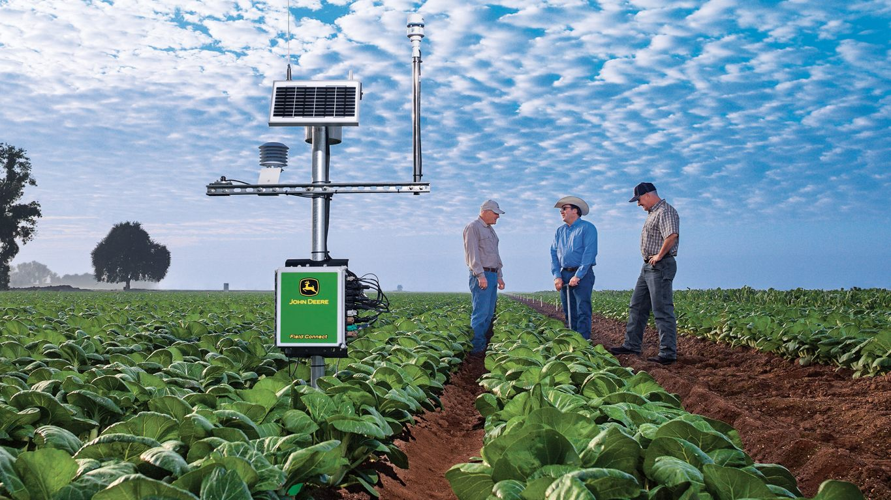
Market Survey
What makes our project unique compared to our main competitor, John Deere’s Field Connect™ pictured below
Advantages
Disadvantages
Lower overall cost
Much higher data resolution
Simpler installation
Cheaper to scale
Shorter lifespan
Higher latency for sensor data
Not built by a trusted company
Figure 1. Field ConnectTM by John Deere
Notes:
Tyler

Slide 10
Potential Risks & Mitigation
Risk
Mitigation
Electronic components malfunction when exposed to some environmental conditions. (like wind, rain, snow, etc.) | Create a waterproof and dustproof casing for the sensor nodes.
If a node survives much longer than we expect and into the next season, it might interfere with future iterations of the system. | Give nodes a suicide mode that ensures they expire at the end of their planned life.
If enough sensor nodes die, the network might not be able to function. | Ensure that sensor nodes are power efficient and have batteries large enough to last six months.
The ground might be frozen when we need to start doing our large scale tests in March. | Shorten duration of large scale tests and be more efficient with our tests.
Notes:
Yuanzhe
Ahmed
Tyler
Yuanzhe

Slide 11
Cost Estimate
Item | Cost Per Unit | Required Count | Total Cost
Gateway | $108.00* | 1 | $108
Sensor Node | $13.94 | ~50 | $697
Web Server | $30.53** | 1 | $30.53
Total Cost of Solution = $835.53
* Assuming solution is used for 6 months with data cost of $5 per month
** Assuming solution is run for 6 months and cost is split across 20 customers
*** Here we used selling prices, the actual base cost shall be lower than this.
Notes:
Dong
https://docs.google.com/spreadsheets/d/1KDOoWxeGJG4zcLF9OO2TQ4pptNQwA2uvSTY5XbJMKig/edit#gid=0
Need to indicate a target cost up front with a specific figure.
Home node:
data will be getting much cheaper over time. Could estimate ~$0.30/month
We have a very expensive choice for our gateway hardware. Could become as cheap as $15.00
We need to be talking about what we think it will cost to manufature and sell these, not the current price.

Slide 12
Milestones and Schedule
August
October
December
March
May
Project Scope Understood and parts ordered
Routing Protocol Implemented
Large Scale Tests Running
Gypsum RH Sensor Created and Tested
Communication Between Web Server and Gateway
Improvements Based on Test Results
Notes:
Tyler

Slide 13
System Design
Notes:
Ahmed

Slide 14
Functional Decomposition
Leaf nodes function
Equipped with sensors, microcontroller, and radio transceivers (NRF24l01).
Will be running a program that allows it to record data.
Transmit data and have it be leapfrogged to the home node/other leaf nodes.
Home node function
Upload sensor data using cellular data connection.
Communicate with sensor nodes using radio transmissions
Web server function
Intuitively soil moisture data to user.
Reliably and permanently store soil moisture data.
Notes:
Ahmed
Yuanzhe
Haoyue

Slide 15
Detailed Design
Notes:
Ahmed

Slide 16
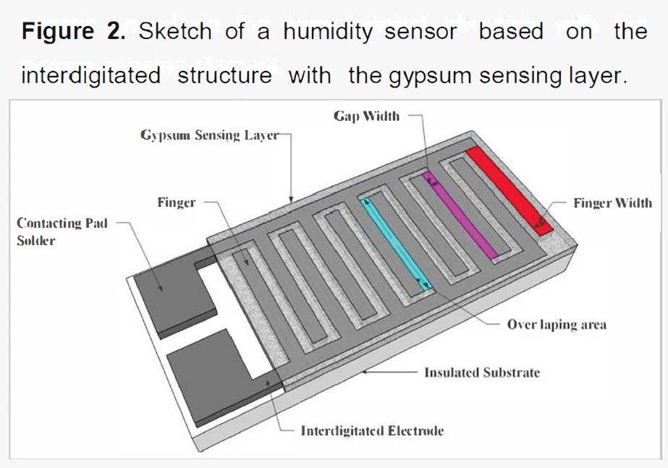
Detailed Design - Gypsum based sensor design:
Insulated substrate
Interdigital electrodes (Cu)
Gypsum (RH sensing material)
Protective layer (Polystyrene) (proposal)
Notes:
Ahmed

Slide 17
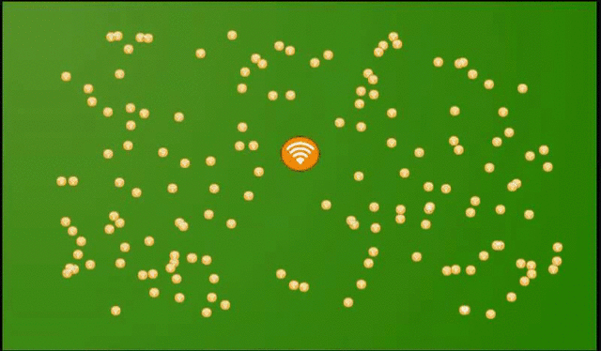
Detailed Design - Routing Protocol
We use an algorithm similar to Dijkstra’s shortest path algorithm.
Messages take the shortest available path to reach the gateway.
Figure 3. Simulation of our Routing Protocol
Notes:
Tyler

Slide 18
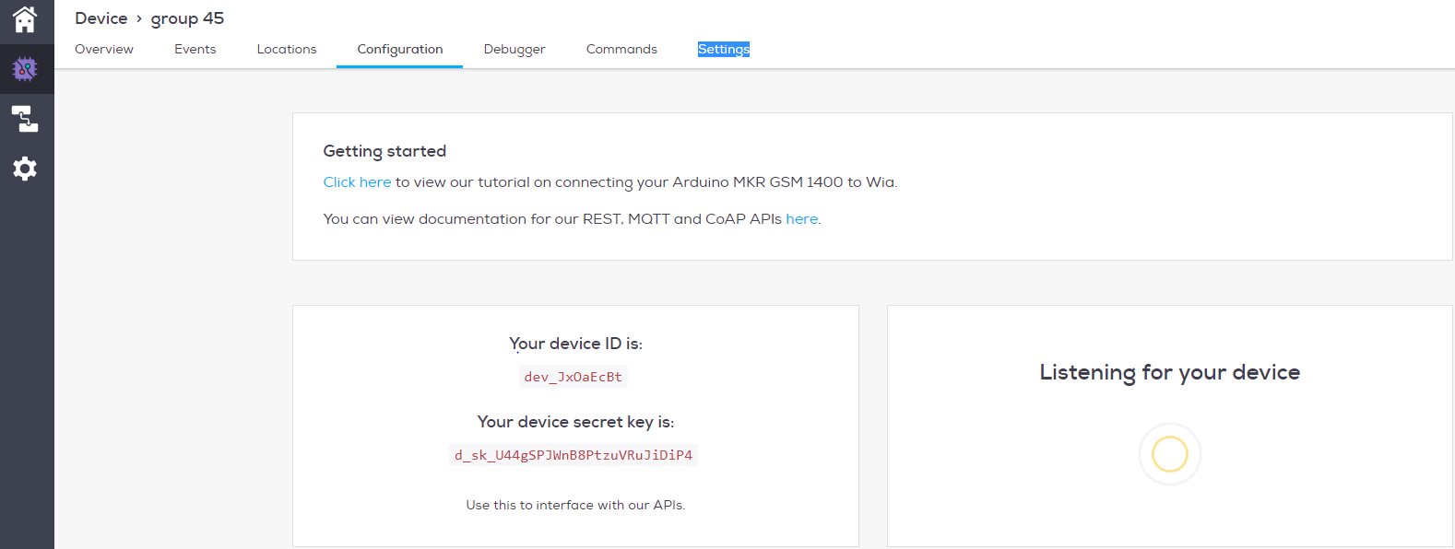
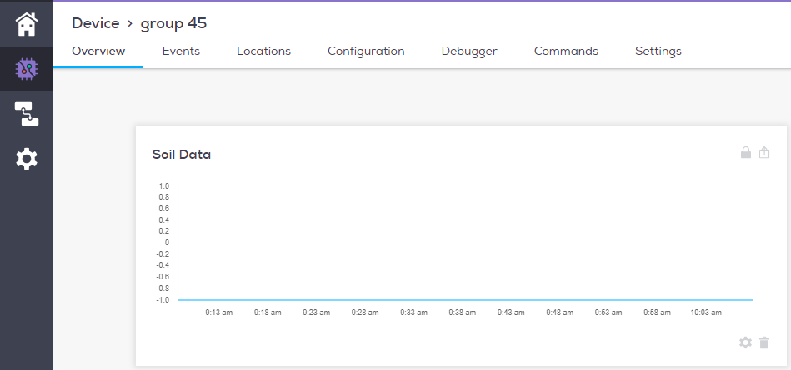
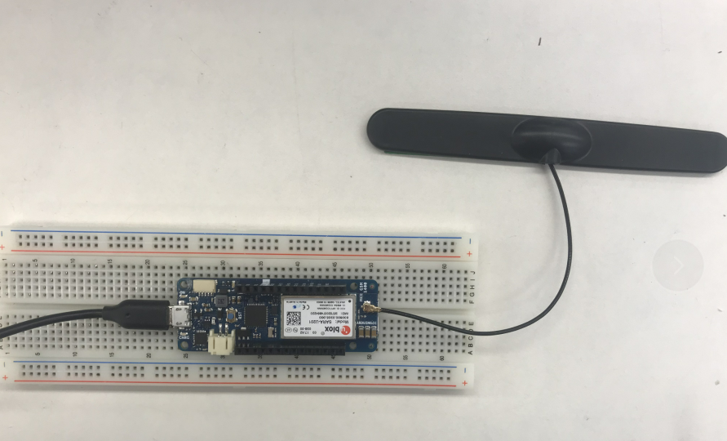
Detailed Design - Internet Gateway
MKR GSM 1400
Antenna
SIM card
Waiting for data to transmit and then upload
Figure 4 the SIM card we use
Automatically create flow charts based on the data uploaded
Figure 6 Testing web server we use
Figure 5. MKR GSM 1400 connected to an antenna
Notes:
Haoyue

Slide 19
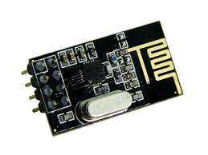
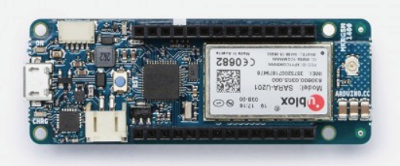
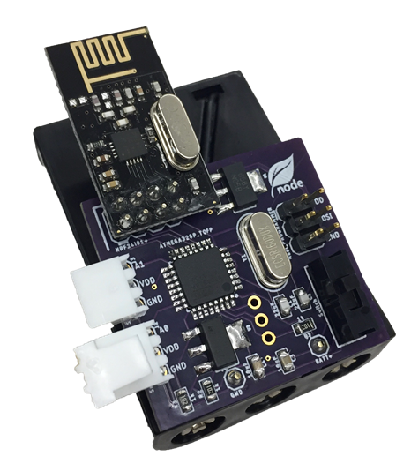
Technology Platforms Used
Gateway
Sensor Nodes
NRF24 Radio
MKR GSM 1400
Atmega328p Microcontroller
PCB of previous Senior Design Group
Notes:
Ahmed

Slide 20
Test Plan
Calibration of humidity sensor to determine the lower and upper level of the output measurement from the sensor. This can be done by placing the sensor in different atmosphere with different RH level.
Test routing protocol by placing many sensor nodes in a field and recording how many nodes are able to accurately get their data to the gateway.
Test longevity of sensor nodes by doing a full scale test for a month and measuring the amount of energy left in the batteries by the end.
Determine the need of Polystyrene to protect the Gypsum and to stabilize the sensor.
Preliminary test for the accuracy of signal transmitted. (One-to-one)
Does the home node receive the correct measured output data from the sensor node? (accuracy of frequency being transmitted)
Notes:
Ahmed
Tyler
Tyler
Ahmed
Yuanzhe

Slide 21
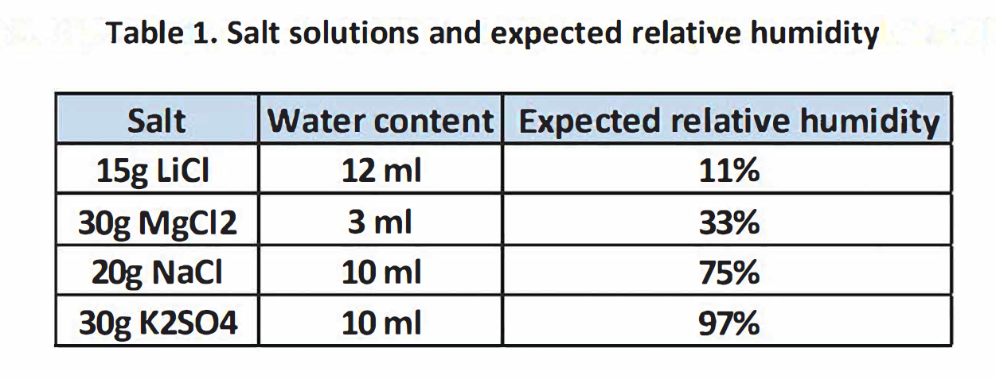
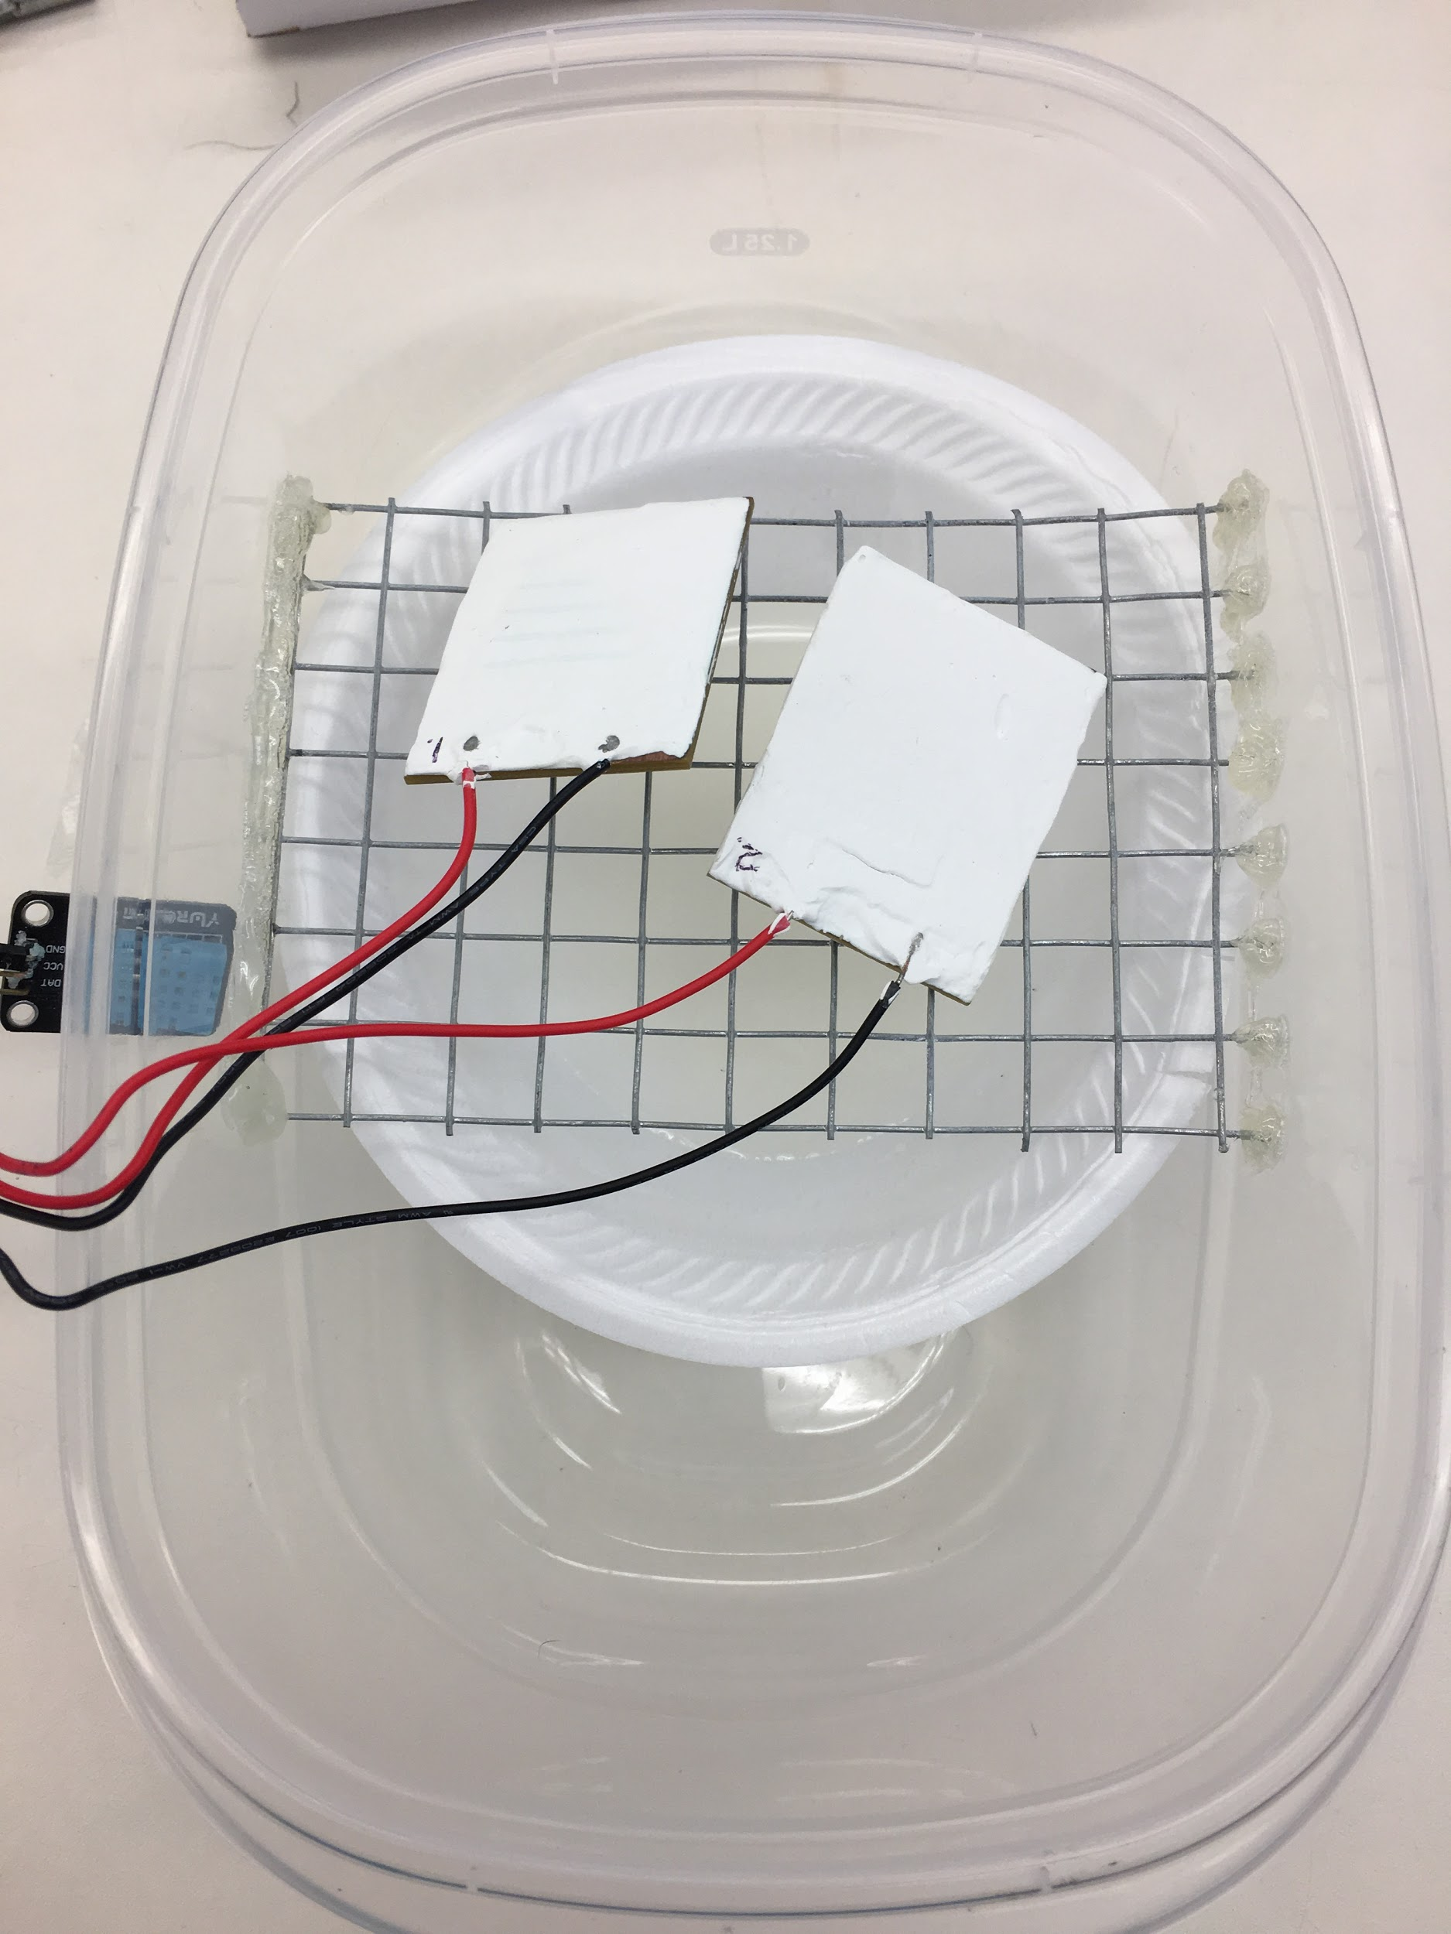
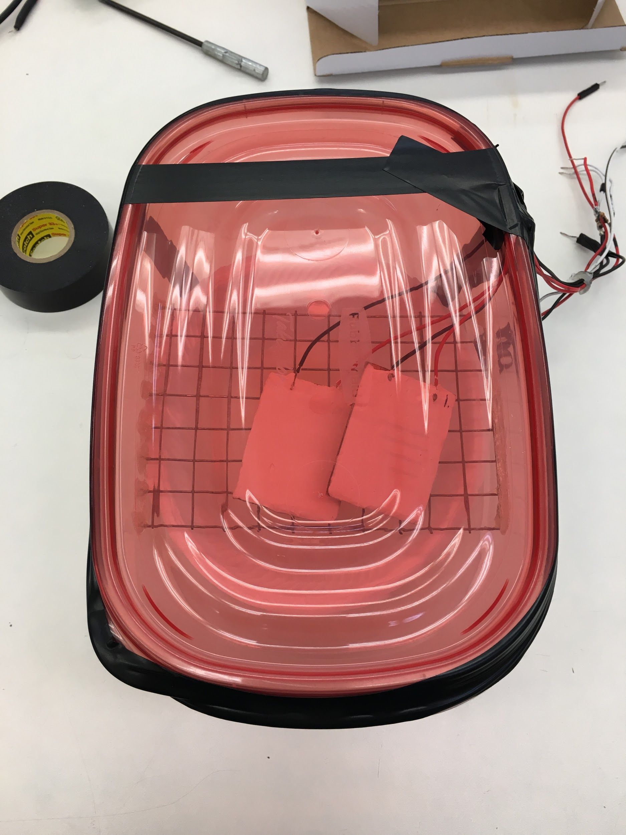
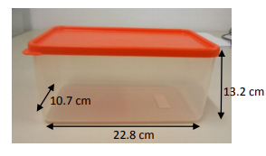
Sensor Calibration
Source: https://www.omega.com/temperature/z/pdf/z103.pdf
Two methods: 1) utilize air/water vapor flow 2) placing a reservoir with saturated salt solution in the chamber
Constraints/ Conditions: 1) Uniform temperature environment (27) 2) Two sensors per trial to insure consistency with the measurements.
3) Consistent container dimensions
Notes:
Ahmed

Slide 22
Prototype Implementations
RH Sensor
Sensor Nodes
Gateway
3G GSM Antenna with U.FL connector
Arduino MKR GSM 1400 board
SIM Card
Plug in
Figure 7. MKR GSM 1400
Notes:
Dong

Slide 23
Conclusion

Slide 24
Current Project Status
Algorithm displayed Figure 3 has been implemented on our sensor node hardware and has been tested on a network of 3 nodes.
We will be constructing more sensor nodes and doing a large scale test soon.
Figure 3. Simulation of our Routing Protocol
Notes:
Tyler

Slide 25
Current Project Status
Circuit & code: data transmit from gateway to the web server are finished.
Testing web server: ready to receive the data from the gateway.
Issues: on the PIN of the SIM card & APN (Access Point Name) when we test the code now. We will solve it as soon as possible.
Notes:
Haoyue

Slide 26
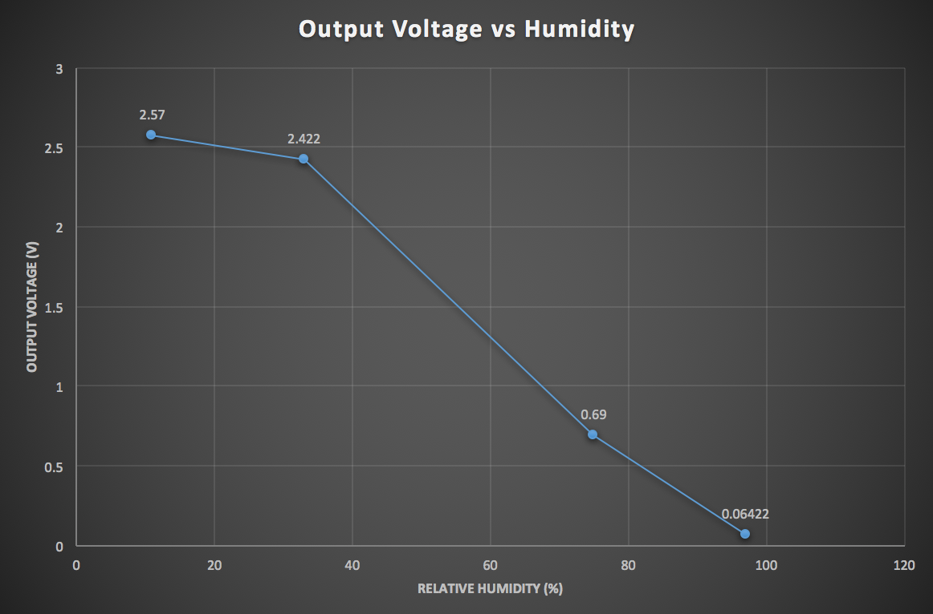
Current Project Status - Calibration Test Result
Shows a linear relationship for humidity > 20~30%
Notes:
Ahmed

Slide 27
Task Responsibilities
Tyler Fritz - Gateway and Sensor nodes
Ahmed Abuhjar - Gateway and Sensor nodes
Dong Xing -Gateway and Web server
Haoyue Ma-Gateway and Web server
Yuanzhe Wang-Gateway and Web server
Notes:
Tyler

Slide 28
Task Responsibilities
Ahmed Abuhjar | Haoyue Ma | Tyler Fritz | Dong Xing | Yuanzhe Wang
1. Design and implement sensor nodes 2. Testing and calibrating the sensors 3. Ensure the accuracy of data transmitted to the home node. 4. Design and implement PCB for the leaf nodes | 1. Connect the circuit for data transmitting from the gateway to the web server. 2. Program and test the code needed for data transmitting to the web server. | 1. Design and implement routing protocol for our mesh network. 2. Ensure that the code running on the sensor nodes uses minimal power. 3. Choosing hardware components for sensor nodes. | 1. Test and improve the accuracy of data transmitted between gateway and to web server. 2. Create understandable & readable flow charts according to the data which the web server received for users to check 3. Set the security account number for the web server | 1. Develop and debug the code for collecting data and transmitting to the web server. 2. Make sure the data transmitted to the web server is accurate.
Notes:
Everyone

Slide 29
Next Semester
January
Run Web Server
Investigate PCB from last semester for the leaf nodes
Node PCB Order
Plan Case Design
February
User Account Security
Build Sensor Node with PCB & casing
Order Cases
March
System Integration
Start Whole Project Testing
April
Get Improvement From Testings
User Acceptance Testing
May
Final Presentation
Notes:
Tyler

Slide 30
Questions

Slide 31
Backup slides

Slide 32
Prototype
Sensor Node
Main Components:
Transceiver Radio Communication
ATMega328p Microcontroller
Design
Node Network
Printed Circuit Board
Power Efficient
Individual Cost: $ ?

Slide 33
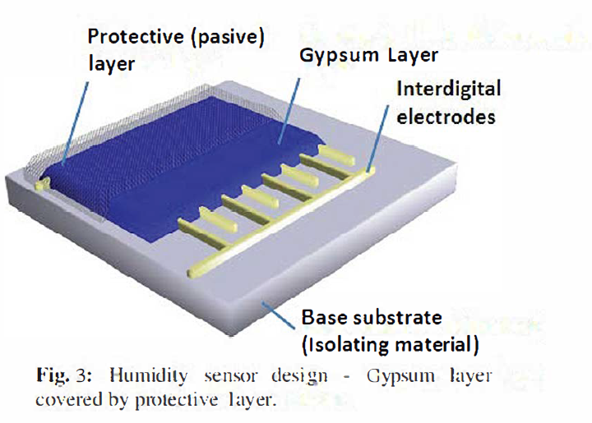
Proposal of adding Polystyrene at the top of the gypsum in the sensor design.

Slide 34
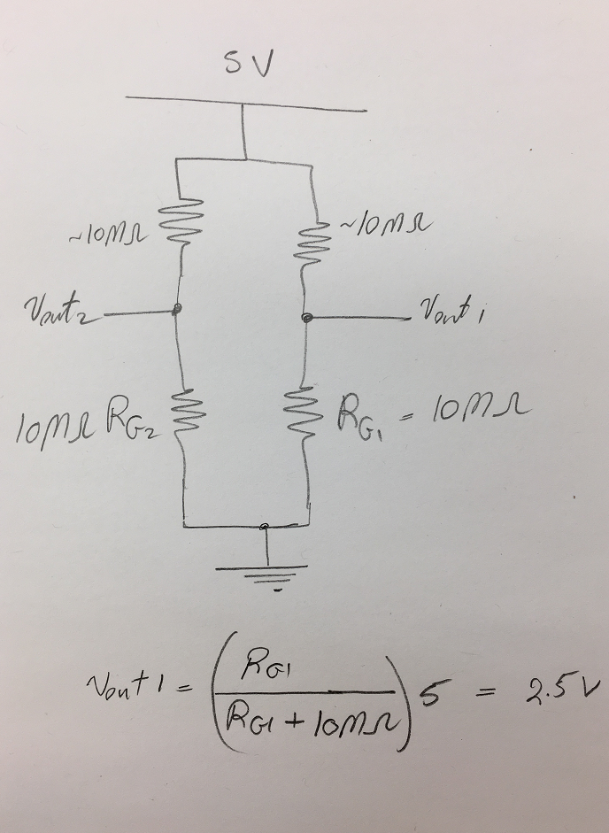
Range of RH measured using our sensor (20%- 90%)
RH range corresponds to the range of output voltage measured at the sensor.
Max Vout = RH of the sensor in the air (completely dry).
Min Vout = 90% RH

Slide 35
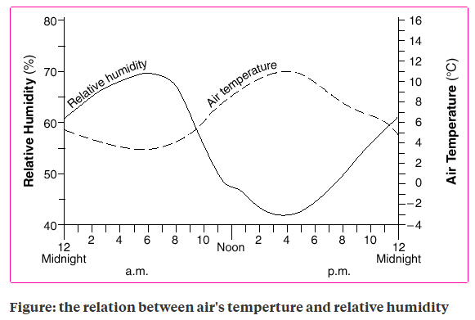
Air temperature vs RH

Slide 36
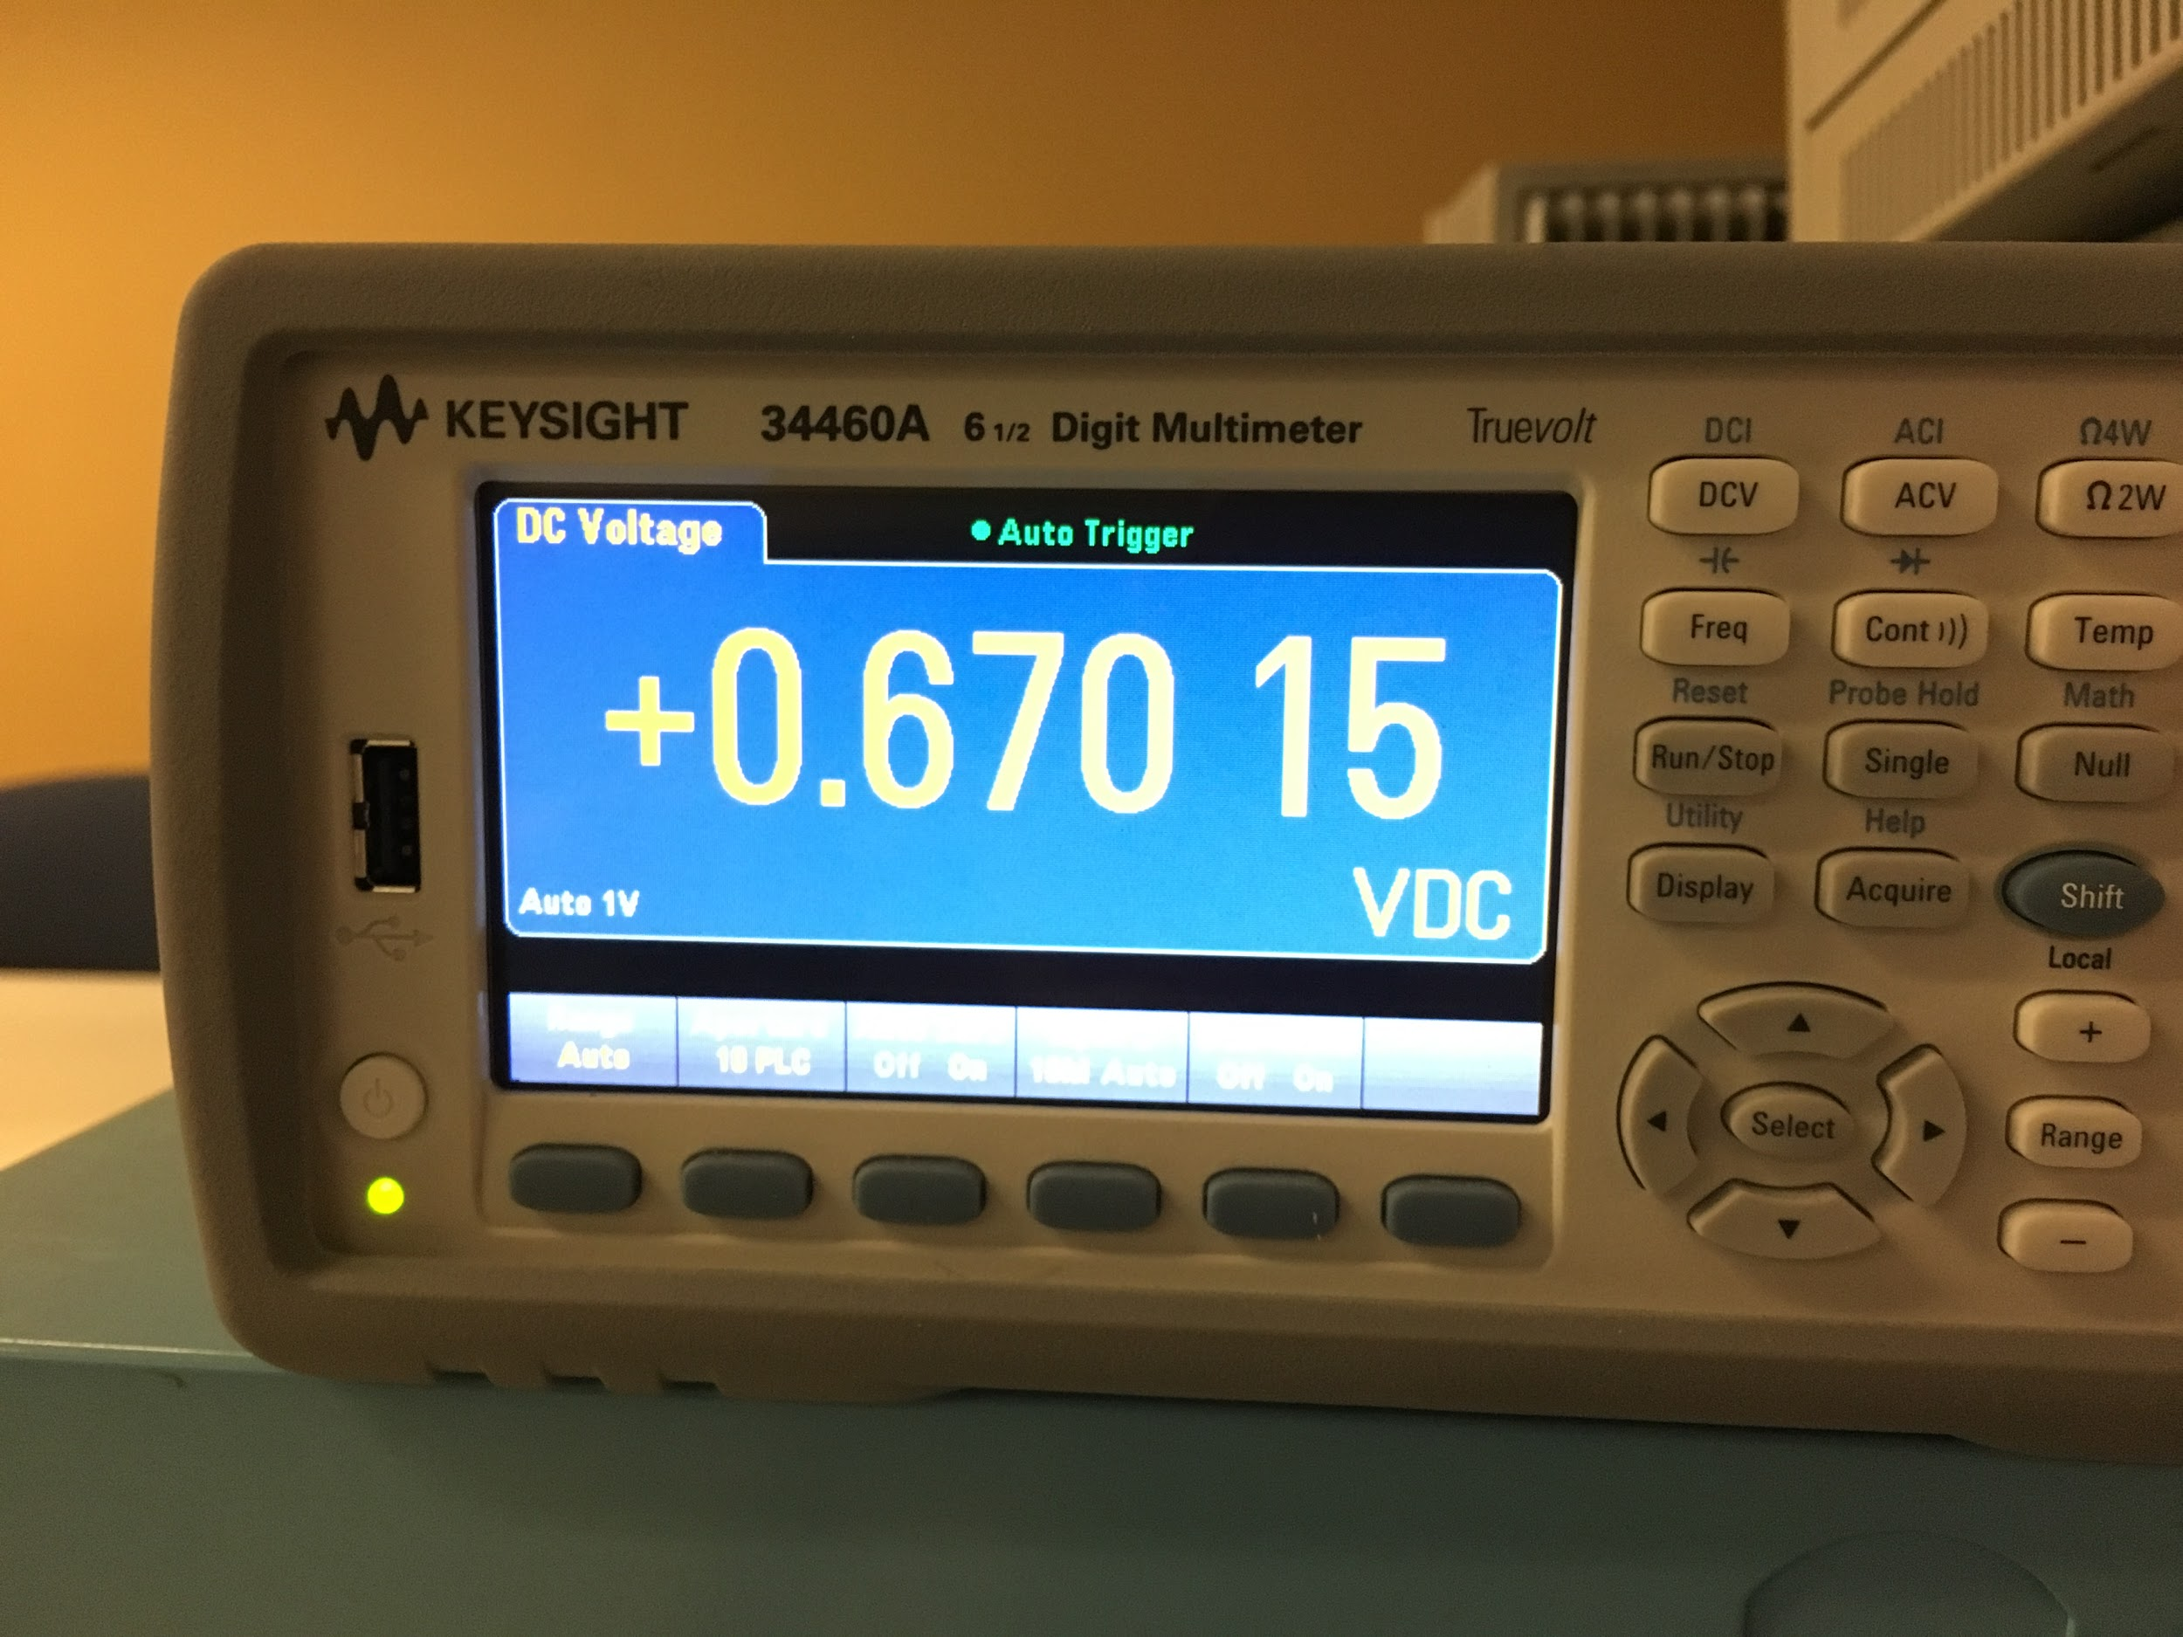
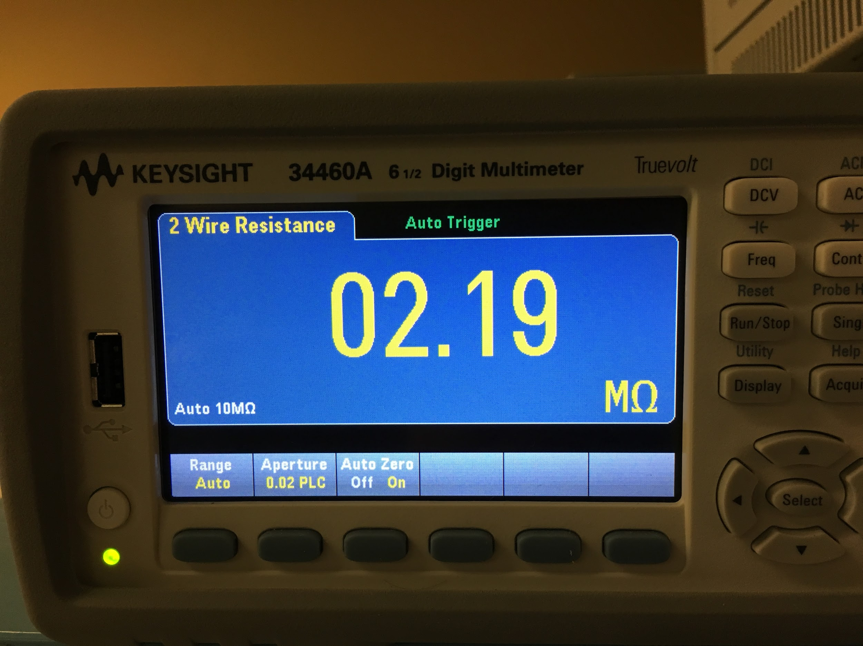
Calibration Test Result (NaCl)
Experiment 1 with NaCl:
Multimeter:
Default (sensor exposed to the air):
Output voltage = 2.5 V
R = 10M
75% RH (NaCl):
Output voltage = 0.69V
R = 2.19M

Slide 37
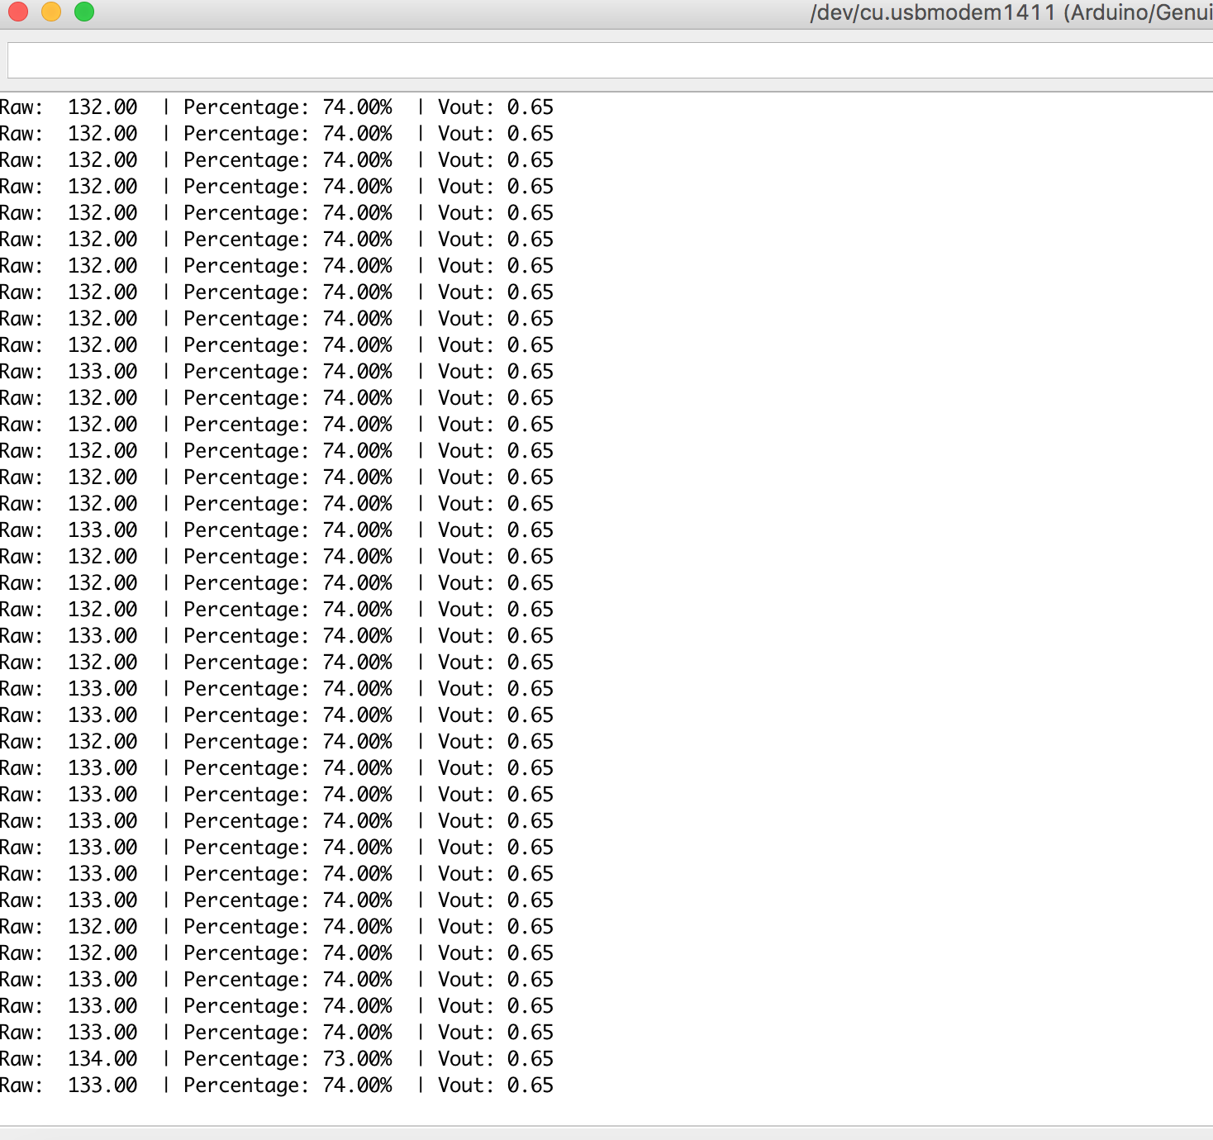
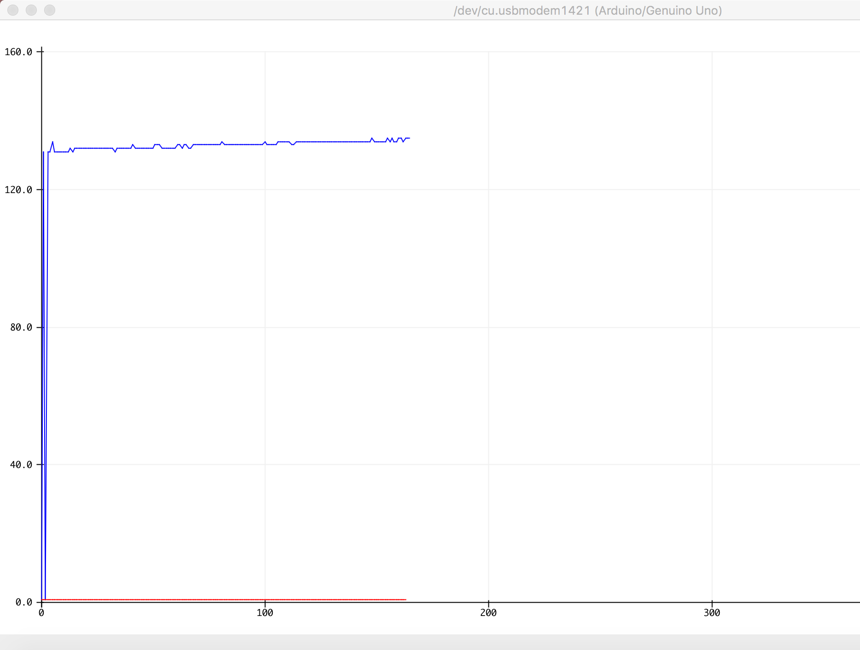
Calibration Test Result (NaCl)

Slide 38
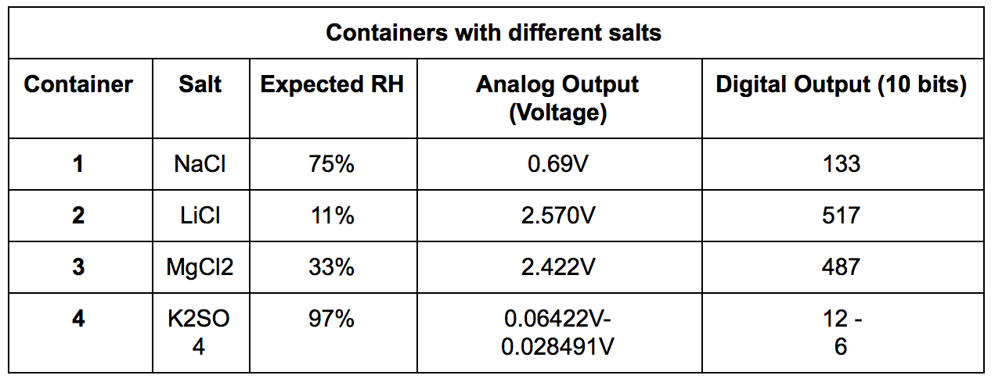
Calibration Test Result

Slide 39
Calibration Test Result
Shows a linear relationship for humidity > 20~30%

Slide 40
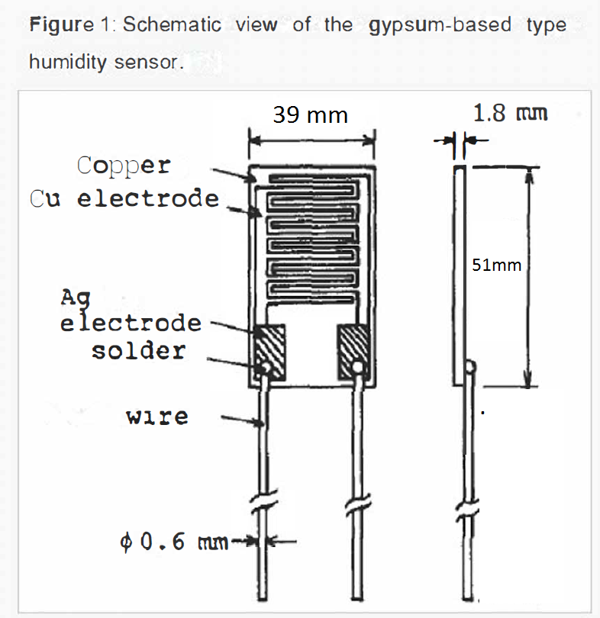
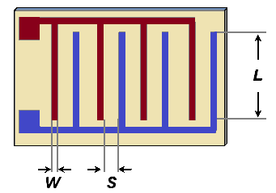
Detailed Design - Gypsum based sensor design:
Controlling Resistivity constant :
The cell resistivity is directly proportional to the electrode area (A), and inversely proportional to the electrode separation (S)

Slide 41
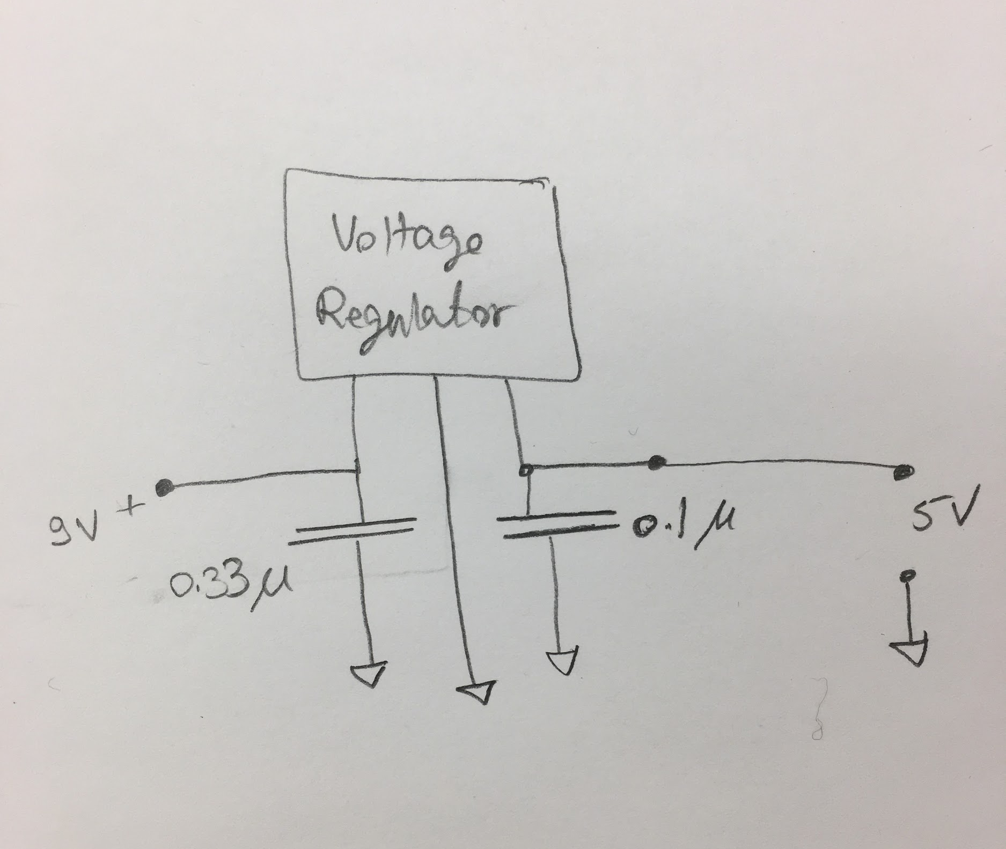
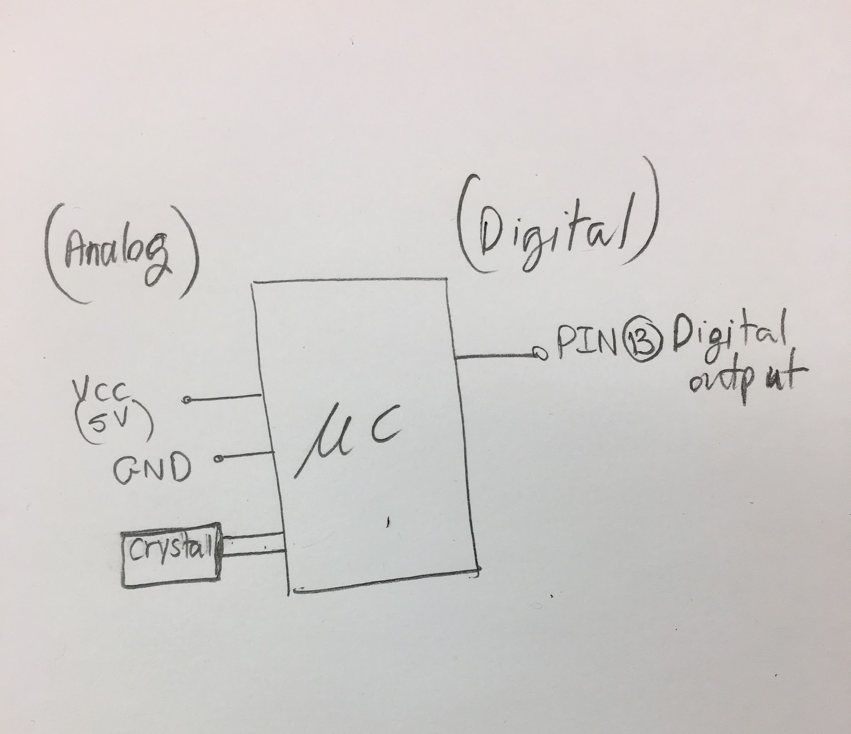
Prototype
Leaf nodes PCB
Voltage Regulator
Microcontroller

